Slide 1
In this segment
Introduction to Enterprise Application Integration
EAI – Overview
Message Channels
Point to Point messaging
Publish-subscribe model

Slide 2
Enterprise Application Integration (EAI)
Introduction
An integration framework composed of a collection of technologies and services which form a middleware or "middleware framework" to enable integration of systems and applications across an enterprise
"unrestricted sharing of data and business processes among any connected application or data sources in the enterprise” - Gartner
Application of EAI
Data integration
Vendor/3rd party independence
Common façade
Patterns
Mediation
Federation

Slide 3
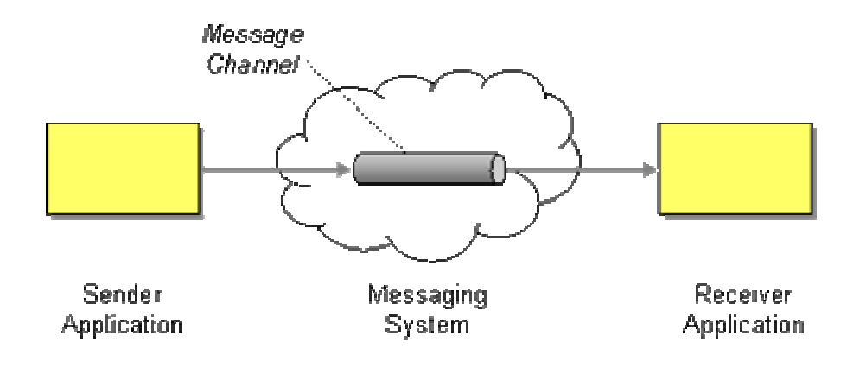
Enterprise Application Integration (EAI)
Message Channels - Overview
Message Channel works as a logical addressing system in Messaging
Messaging Channel acts as a medium of communication between two specific applications in a complex enterprise, where in the sender application selects which particular ”channel” of the messaging system to use, that designates the target application/ group of applications.
Design challenges
One to one or one to many
Data type channel
Invalid and dead message handling
Crash proof design / Guaranteed delivery
Non-messaging client access - Channel adapter
Communications backbone – Message bus

Slide 4
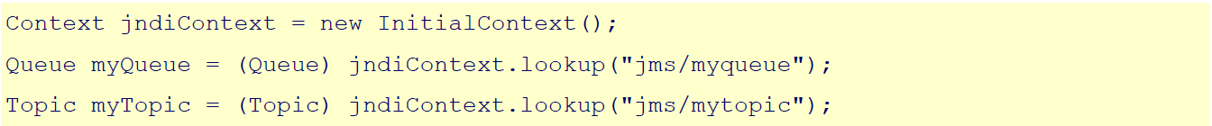
Enterprise Application Integration (EAI)
Message Channels – Example (JMS)
Configuring Message channels (Queues and Topics)
Accessing Message channels

Slide 5
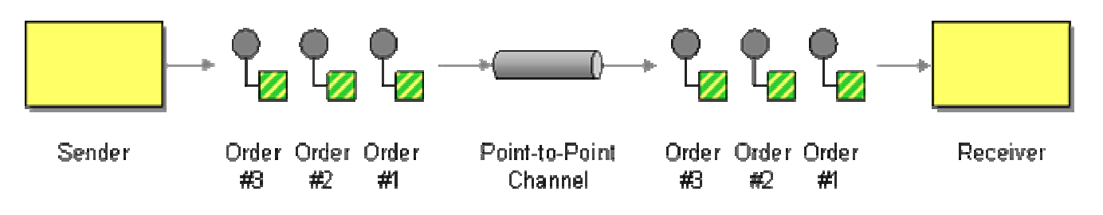
Enterprise Application Integration (EAI)
Point to point channel
Point-to-Point Channel ensures that only one receiver consumes any given message, irrespective of number of receivers in that channel
Increases scalability in multi consumer applications
JMS Implementation uses ‘Queue’ interface to implement Point to point channel
QueueSender – send messages
QueueReceiver – receive messages

Slide 6
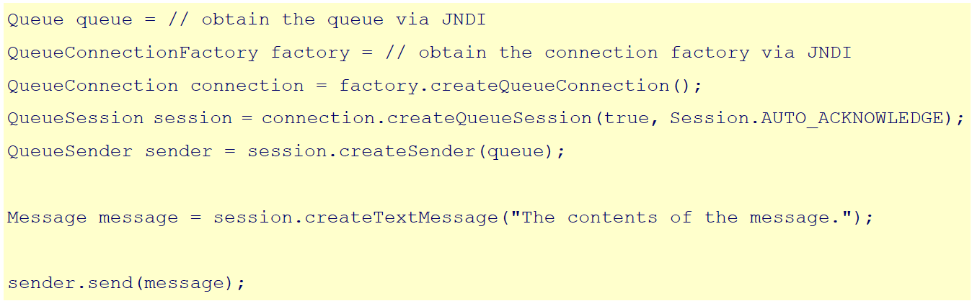
Enterprise Application Integration (EAI)
Point to point channel – Example (JMS)
Sending message

Slide 7
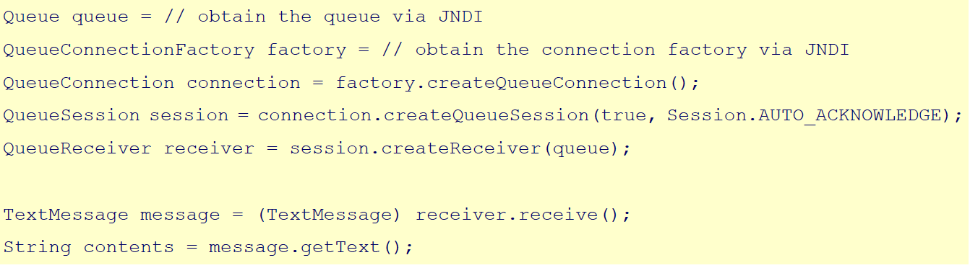
Enterprise Application Integration (EAI)
Point to point channel – Example (JMS)
Receiving message

Slide 8
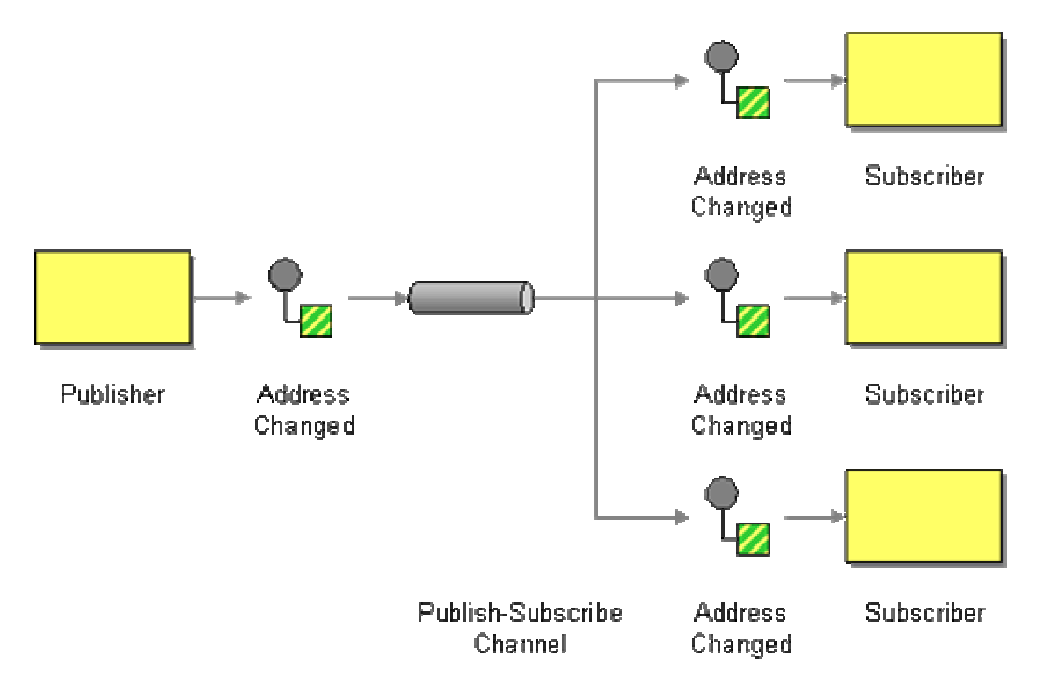
Enterprise Application Integration (EAI)
Publish - subscribe channel
Used for broadcasting messages to each recipient in the channel
Ensures that each recipient gets only one copy of the message
Helps in debugging channel without disturbing traffic
JMS Implementation uses ‘Topic’ interface to implement Point to point channel
TopicPublisher – send messages
TopicSubscriber – receive messages

Slide 9
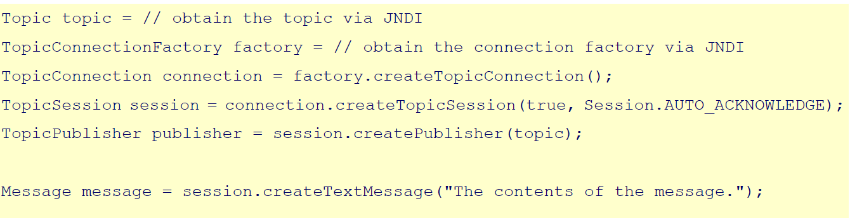
Enterprise Application Integration (EAI)
Publish - subscribe channel – Example (JMS)
Sending message

Slide 10
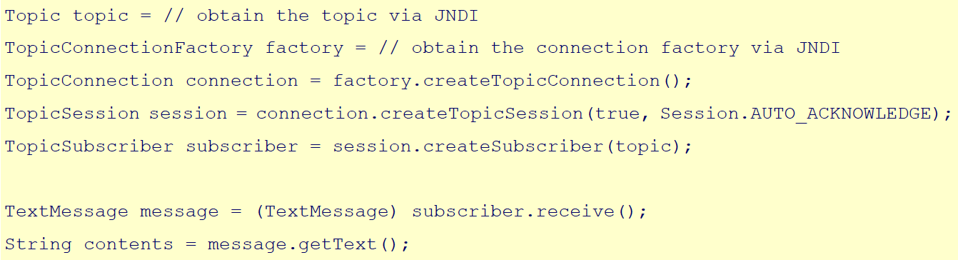
Enterprise Application Integration (EAI)
Publish - subscribe channel – Example (JMS)
Receiving message

